Slide 1
Final Engagement
Attack, Defense & Analysis of a Vulnerable Network
By Tricia Tambio, Ryan Ichigaya, Zac Turner

Slide 2

Table of Contents
This document contains the following resources:
Network Topology & Critical Vulnerabilities
Offense
Defense
Networking
Appendix

Slide 3

Network Topology
& Critical Vulnerabilities
‹#›

Slide 4
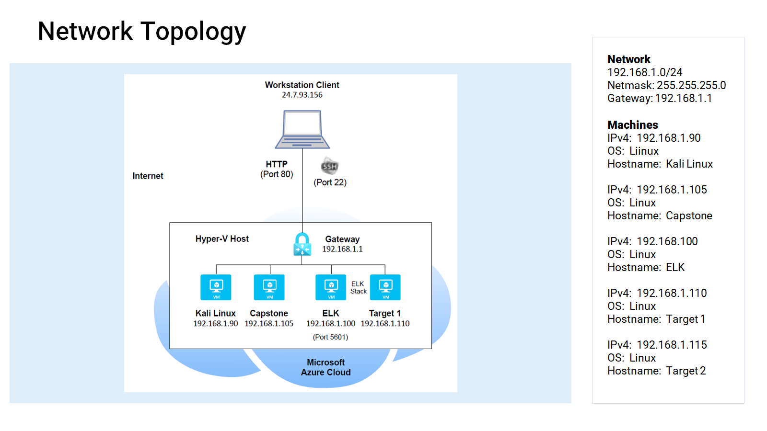

Slide 5
Critical Vulnerabilities: Target 1
Our assessment uncovered the following critical vulnerabilities in Target 1.
Vulnerability | Description | Impact
CWE-672 Operation of a resource after expiration or release. | The software uses, accesses, or otherwise operates on a resource after that resource has been expired, released, or revoked. | Using outdated versions of software leaves the target vulnerable to exploits.
CWE-307 Improper restriction of excessive authentication attempts. | The software does not implement sufficient measures to prevent multiple failed authentication attempts within in a short time frame, making it more susceptible to brute force attacks. | A malicious actor can use a program to rapidly attempt to guess a username or password as many times as it would like until it successfully logs in.
CWE-256 Plaintext storage of a password. | Storing a password in plaintext may result in a system compromise. | Storing a plaintext password in a configuration file allows anyone who can read the file access to the password-protected resource.
CWE-269 Improper privilege management. | The software does not properly assign, modify, track, or check privileges for an actor, creating an unintended sphere of control for that actor. | Giving the user Steven root access to python granted our team the ability to run a simple code to escalate to root.
Notes:
Reference: https://cwe.mitre.org/

Slide 6
Exploits Used
‹#›

Slide 7
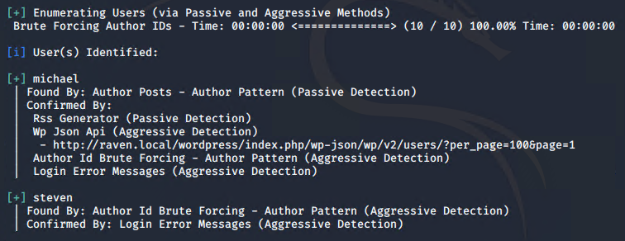
Exploitation: Outdated Resources (CWE-672) & Unlimited Authentication (CWE-307)
The Target was using an outdated version of Wordpress, which allowed the use of Wpscan.
wpscan –url http://raven.local/wordpress --enumerate u
Using Wpscan, our team was able to brute force the Target exposing active users:
* See Appendix A1 & A2 - Outdated Resources & Unlimited Authentication for tools and techniques used.

Slide 8
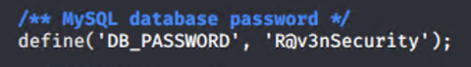
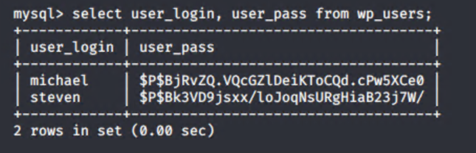
Exploitation: Plaintext Storage of Passwords (CWE-256)
After being able to SSH into Michael’s machine, Red Team was able to access wp-content in /var/www/html/wordpress
This revealed a plaintext password to the MySql database.
Inside the MySql database we enumerated a list of users and their password hashes.
* See Appendix B1 & B2 – Plaintext Storage of Passwords for tools and techniques used.

Slide 9
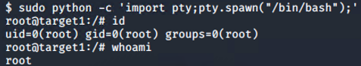
Exploitation: Improper Privilege Management (CWE-269)
Command to escalate privilege to ‘root’ on Target 1:
sudo python –c ‘import pty;pty.spawn(“/bin/bash”);’
We are now logged in as ‘root’.
* See Appendix C1 - C3 – Improper Privilege Management for tools and techniques used.

Slide 10
Avoiding Detection
‹#›

Slide 11
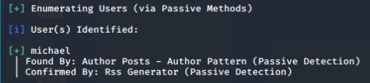
Stealth Exploitation of Outdated Resources & Unlimited Authentication
Monitoring Overview
Outdated Resources
CPU Usage Monitor
Measures CPU usage as a percentage.
Above 0.5% for 5 minutes.
Unlimited Authentication
Excessive HTTP Errors
HTTP errors
Above 400 within 5 minutes.
Mitigating Detection
Use Wpscan in stealth mode:
wpscan --url http://raven.local/wordpress --stealthy --enumerate u

Slide 12
Stealth Exploitation of Improper Privilege Management
Monitoring Overview
Authorization SUDO Command Usage Monitor
Sudo commands executed.
Above or equals 5 for the last 1 minute.
Mitigating Detection
Extremely hard to detect if the malicious actor is precise.
Delete log history

Slide 13
Maintaining Access
‹#›

Slide 14
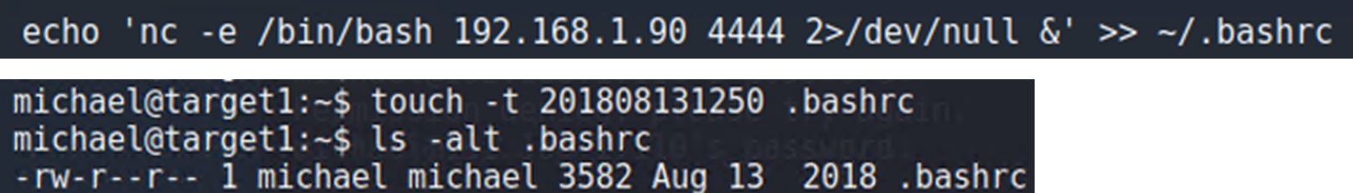
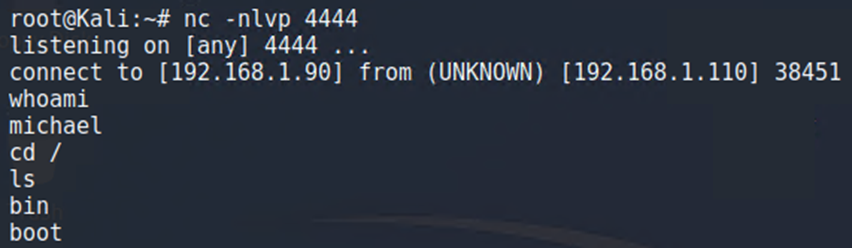
Backdoor Access: Reverse shell
Backdoor technique: Installed a reverse shell on a user’s .bashrc file.
Exploit: Logged in as Michael and added the code for an interactive session. The file’s modification time was changed back to its original time.
Connect: From Kali, opened up a listener, waited for Michael to log in, then gained access to exploit his machine:
See Appendix D –Backdoor Access for an example of a sudoers file backdoor access.

Slide 15
Alerts Implemented
‹#›

Slide 16
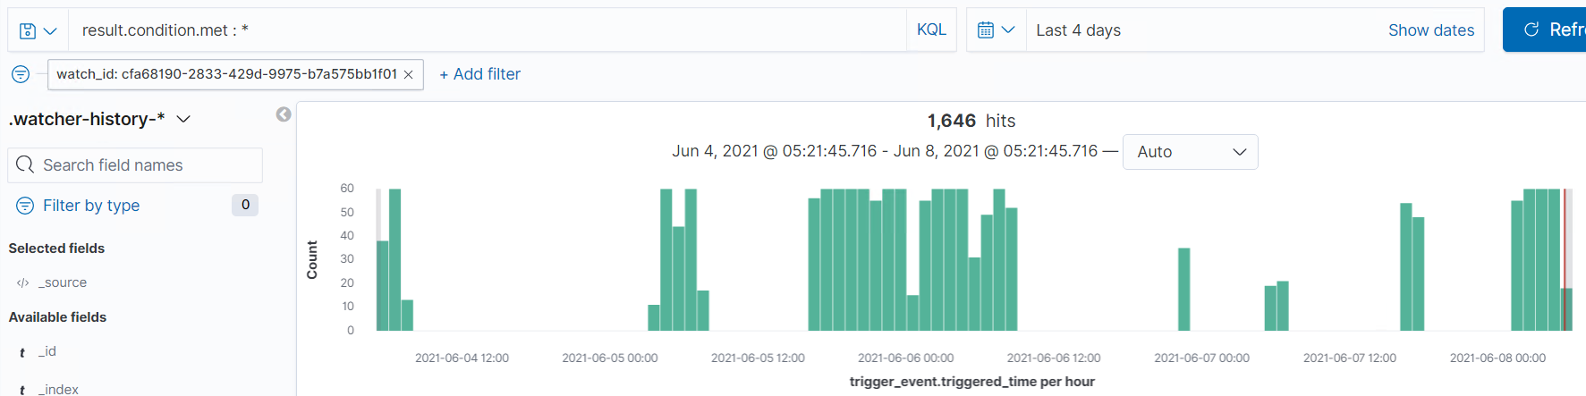
CPU Usage Monitor
Which metric does this alert monitor?
System.process.cpu.total.pct
What is the threshold it fires at?
When max of ‘system.process.cpu.total.pct’ over all documents is above 0.5 for the last 5 minutes.
Screenshot of the alert in action:

Slide 17
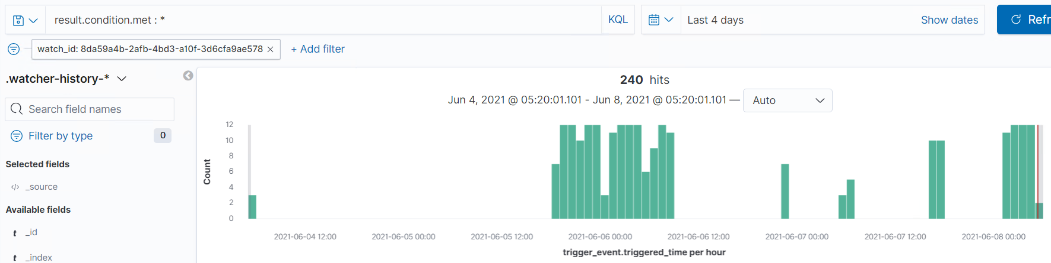
Excessive HTTP Errors
Which metric does this alert monitor?
Http.response.status_code
What is the threshold it fires at?
When the count grouped over top 5 ‘http.response.status_code’ is above 400 for the last 5 minutes.
Screenshot of the alert in action:

Slide 18
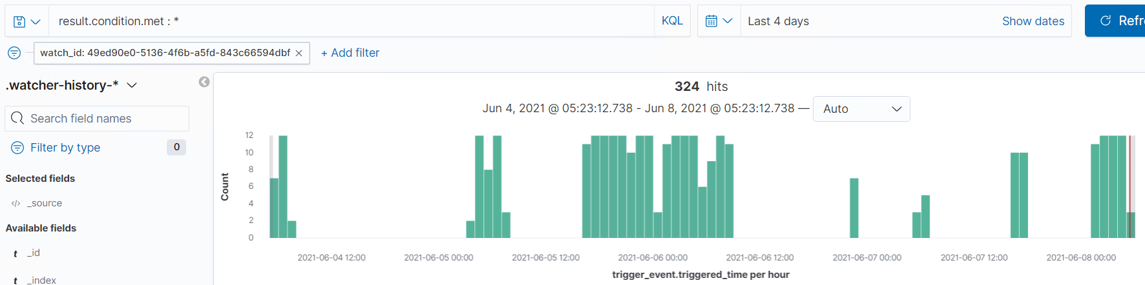
HTTP Request Size Monitor
Which metric does this alert monitor?
http.request.bytes
What is the threshold it fires at?
When the sum of ‘http.request.bytes’ over all documents is above 3500 for the last 1 minute
Screenshot of the alert in action:

Slide 19
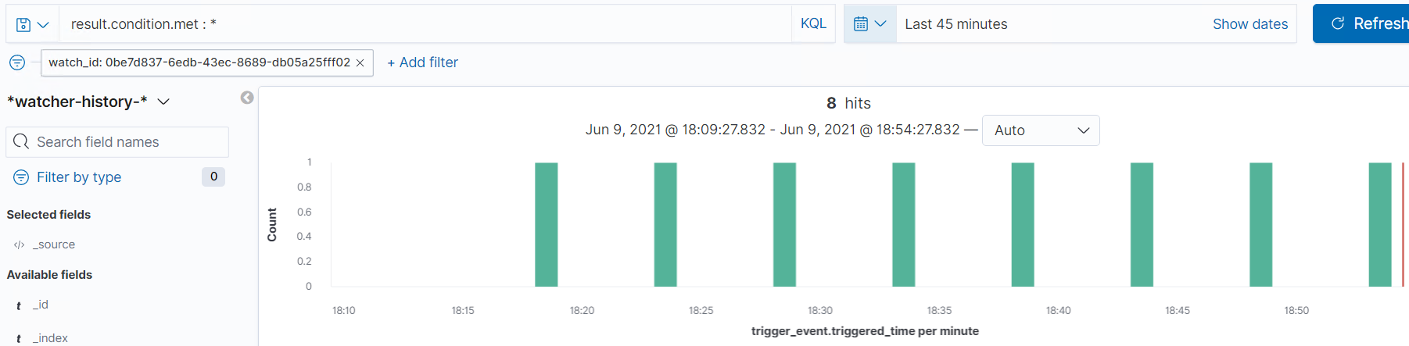
Authorization SUDO Command Usage Monitor
Which metric does this alert monitor?
system.auth.sudo.command
What is the threshold it fires at?
When the count grouped over top 10 ‘system.auth.sudo.command’ is above or equals 5 for the last 1 minute.
Screenshot of the alert in action:

Slide 20
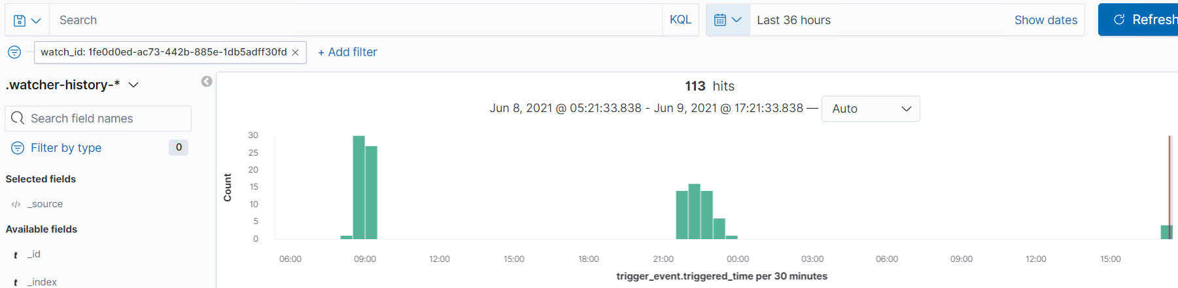
Excessive SSH Authorization
Which metric does this alert monitor?
system.auth.ssh.event
What is the threshold it fires at?
When the count grouped over top 3 ‘system.auth.ssh.event’ is above or equals 5 for the last 1 minute.
Screenshot of the alert in action:

Slide 21

Hardening
‹#›

Slide 22
Hardening Against Outdated Resources & Unlimited Authentication
Hardening against Outdated Resources:
Update Wordpress.
Edit the theme’s functions.php to block username enumeration.
Install the WordPress plugins.
Block author scans by modifying the .htaccess code.
Hardening against Unlimited Authentication:
Password complexity.
Enable multi-factor authentication.
Restrict the number of login attempts.
Enable CAPTCHA (Completely Automated Public Turing test to tell
Computers and Humans Apart).

Slide 23
Hardening Against Plaintext Storage of Passwords
Hardening against Plaintext Storage of Passwords:
Encrypt sensitive files and network traffic.
Restrict access to specific files by using an access control list.
Use the least privilege principle when granting access in the MySQL ‘grant’ table.
Update security patches.
Educate users about the organization’s AUP (Acceptable Use Policy)/password policies.

Slide 24
Hardening Against Improper Privilege Management
The hardening against improper privilege management should include the following:
Restrict sudo access.
Use the principle of least privilege.
Perform system audits.
Use a monitoring system.

Slide 25
Implementing Patches
‹#›

Slide 26
Implementing Patches with Ansible
Playbook Overview
Listed below are some examples of how we can use Ansible to update patches:
- WordPress command line interface, ‘wp-cli’ to configure installations and update plugins.
- Patch updates to Linux servers using Ansible roles.
- Updates to ‘sshd’ configuration file and ‘sudo’ rules to secure remote access.

Slide 27
Traffic Profile
‹#›

Slide 28
Traffic Profile
Our analysis identified the following characteristics of the traffic on the network:
Feature | Value | Description
Top Talkers (IP Addresses) | 172.16.4.205 185.243.115.84 10.0.0.201 166.62.111.64 | Machines that sent the most traffic.
Most Common Protocols | TCP | Three most common protocols on the network.
# of Unique IP Addresses | 808 | Count of observed IP addresses.
Subnets | 10.6.12.0/24 | Observed subnet ranges.
# of Malware Species | 1 | Number of malware binaries identified in traffic.
Notes:
You may have more than 2 subnets.

Slide 29
Behavioral Analysis
Purpose of Traffic on the Network
Users were observed engaging in the following kinds of activity.
“Normal” Activity
Working in an active directory.
Using file share.
Various searches.
Watching Youtube.
Suspicious Activity
Downloading viruses.
Working on personal Wordpress sites.
Establishing personal active directories.

Slide 30
Behavioral Analysis
Purpose of Traffic on the Network
Users were observed engaging in the following kinds of activity.
“Normal” Activity
Category of websites visited: news, lifestyle, health, merchandise, events
Suspicious Activity
Personal Web Server
Malware downloaded
Infected Windows Machine
Illegal Downloads

Slide 31
Normal Activity
‹#›

Slide 32
Normal Behavior
Summarize the following:
What kind of traffic did you observe? Which protocol(s)?
Primarily tcp
some udp
What, specifically, was the user doing?
mysocalledchaos (Youtube)
google
emails (Comcast, Yahoo).

Slide 33
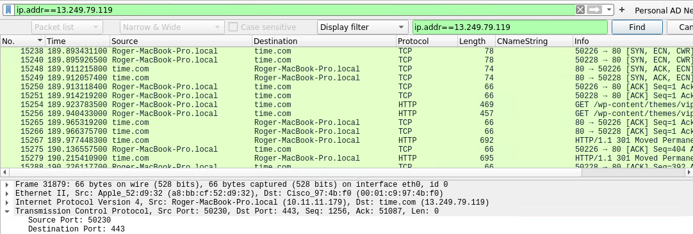
Websites – News
News website visited:
Domain Name: www.time.com
Host Name: Roger-MacBook-Pro
IP Address: 10.11.11.179

Slide 34
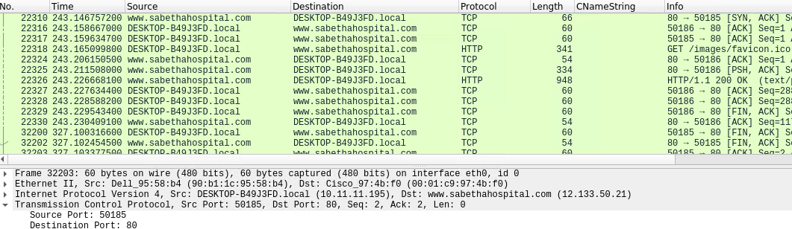
Websites – Health
Health website visited.
Domain Name: www.saberthahospital.com
Host Name: DeskTOP-849J3FD
IP Address: 10.11.11.195

Slide 35
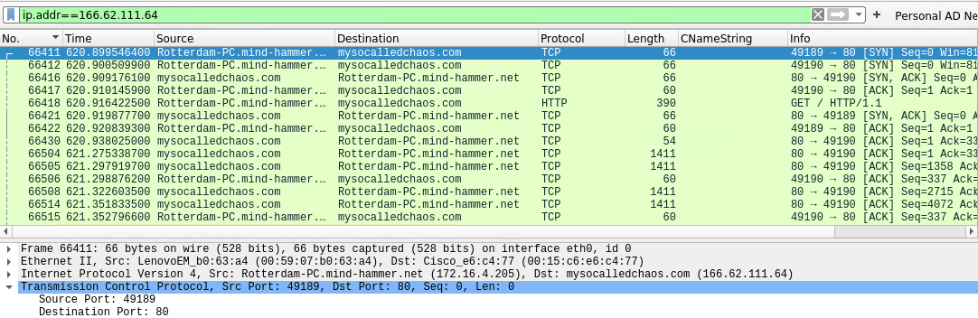
Websites – Lifestyle Blog
Lifestyle website visited.
Domain Name: www.mysocalledchaos.com
Host Name: Rotterdam-PC
IP Address: 172.16.4.205
NOTE: Findings found that this machine is infected!

Slide 36
Malicious Activity
‹#›

Slide 37
Suspicious Behavior
The primary suspicious protocol traffic was http.
Downloading viruses (june11.dll)
Illegally downloading videos (Betty Boop)
Establishing personal active directories

Slide 38
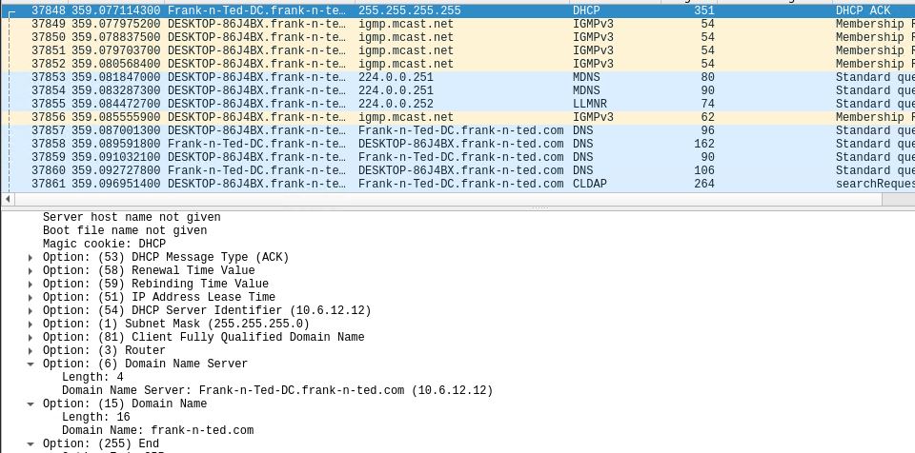
Personal Web Server
Personal web server created on corporate network.
Domain Name: www.frank-n-ted.com
IP Addresses: 10.6.12.0/24
Domain Controller IP Address: 10.6.12.12

Slide 39
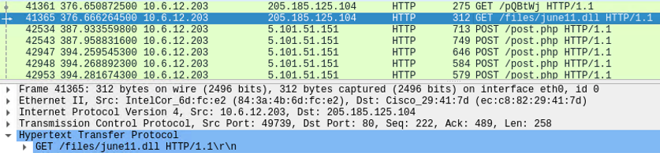
Malware Downloaded
Request to download a malware file.
Source IP Address: 10.6.12.203 port 49739
Destination IP Address: 205.185.125.104 port 80
Malware File: ‘june11.dll’
Classification (from www.virustotal.com): Malicious Trojan Horse

Slide 40
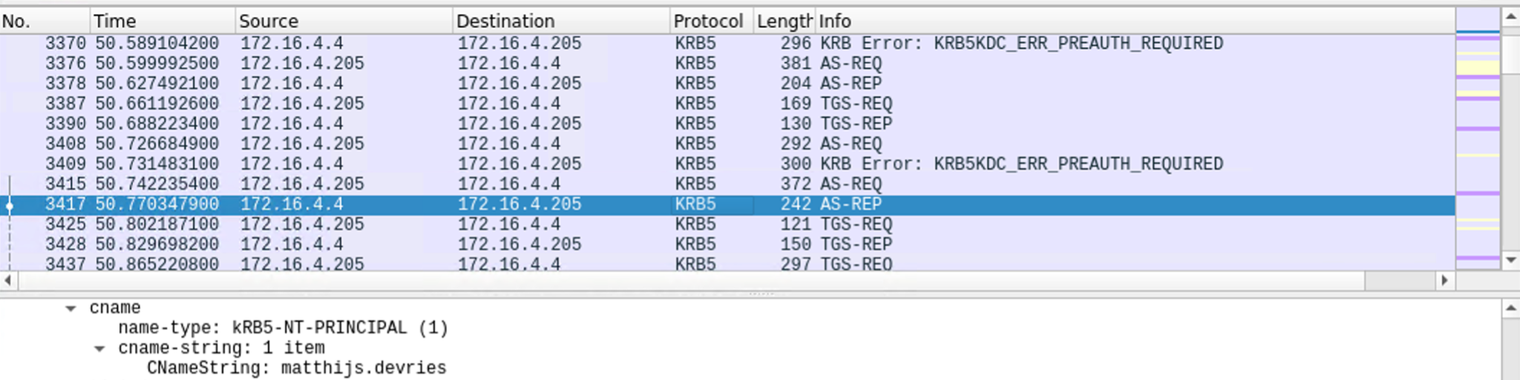
Infected Windows Host
Vulnerable Windows machine connected to network.
Host Name: Rotterdam-PC
IP Address: 172.16.4.205
MAC Address: 00:59:07:b0:63:a4
Domain Controller (DC) IP Address: 172.16.4.4
Domain Controller Name: Mind-Hammer-DC
Windows Username: ‘matthijs.devries’

Slide 41
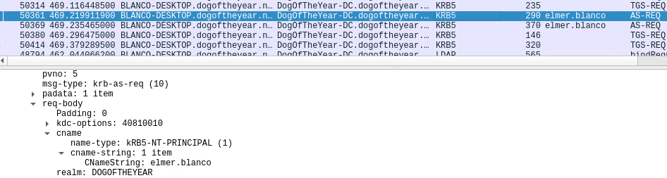
Illegal Downloads
Torrenting occurring within the network.
Source IP Address: 10.0.0.201
MAC Address: Msi_18:66:c8
Windows Username: ‘elmer.blanco’
Torrent File: ‘Betty_Boop_Rhythm_on_the_Reservations.avi.torrent’
Website: www.publicdomaintorrents.com.

Slide 42
The End
‹#›

Slide 43
Appendix
‹#›

Slide 44
Appendix A1: Outdated Resources & Unlimited Authentication
The following tools and techniques were used to enumerate the usernames from the WordPress site:
- nmap
- Web browser
- wpscan
We performed a port scan to retrieve host and service information.
From this scan, we were able to find the URL for this WordPress site which then allowed us to enumerate the WordPress site to identify WordPress users.

Slide 45
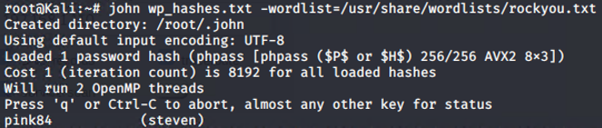
Appendix A2: Outdated Resources & Unlimited Authentication
The following tools and techniques were used to crack the hash passwords found in the MySQL server on Target 1:
- Linux commands
- ‘John the Ripper’ tool
Command to brute force the hash passwords:
john wp_hashes.txt –wordlist=/usr/share/wordlists/rockyou.txt

Slide 46
Appendix B1: Plaintext Storage of Passwords
The following tools and techniques were used to access directories and sensitive information on Target 1:
- Linux commands
- MySQL Server
After remotely gaining access into Target 1, we were able to search through the directories to find sensitive information.
Information accessed:
- ‘wp-config.php’
- MySQL databases & tables
- WordPress user password hashes

Slide 47
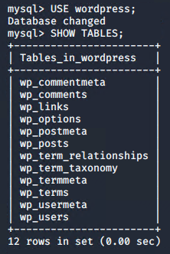
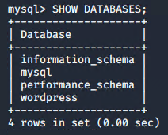
Appendix B2: Plaintext Storage of Passwords (con’t)
After finding the MySQL database user and password, we were able to gain access to the databases and tables in the MySQL server on Target 1.
Commands to log into the MySQL server
and list available databases and tables:
mysql –u root –pR@v3nSecurity
SHOW DATABASES;
USE wordpress;
SHOW TABLES;

Slide 48
Appendix C1: Improper Privilege Management
The following tools and techniques were used to escalate privilege as the ‘root’ user on Target 1:
- ssh command
- python command
After cracking the password for a user, we were able to remotely access the Target 1 machine.
Then we checked for the sudo privileges this user had in order to escalate his privilege to ‘root’.

Slide 49
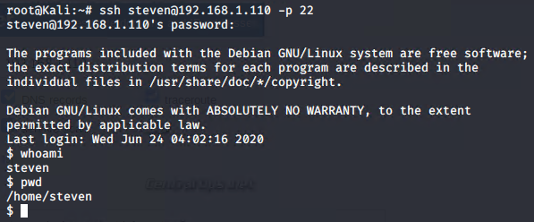
Appendix C2: Improper Privilege Management (con’t)
Command to perform remote host access to Target 1:
sudo ssh steven@192.168.1.110 –p 22
- Again, we are able to maneuver within the system.

Slide 50
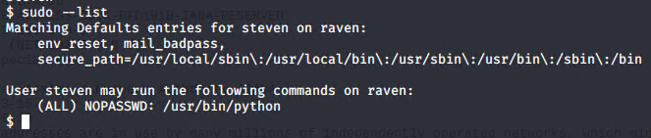
Appendix C3: Improper Privilege Management (con’t)
Command to check for the sudo privileges a user has access to on Target 1:
sudo --list
The user has access to the Python executable.

Slide 51
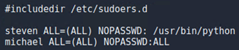
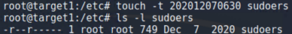
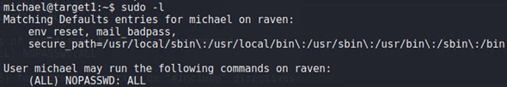
Appendix D: Backdoor Access
Backdoor technique: Modified the sudoers file to give a user all sudo access.
Exploit: Logged in as root (Steven) and granted Michael all sudo access. The file’s modification time was changed back to its original time.
Connect: From Kali, logged in as Michael and now has the ability to exploit the Target machine:

